Slide 1
Lecture 29
IEEE 1149.1 JTAG
Advanced Boundary Scan
& Description Language (BSDL)
Special scan cells and pins
Cell timing / wiring constraints
Cell delay measurements
Boundary Scan Description Language
Summary

Slide 2
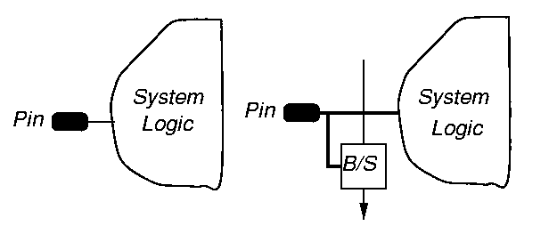
Observe-Only Scan Cell

Slide 3
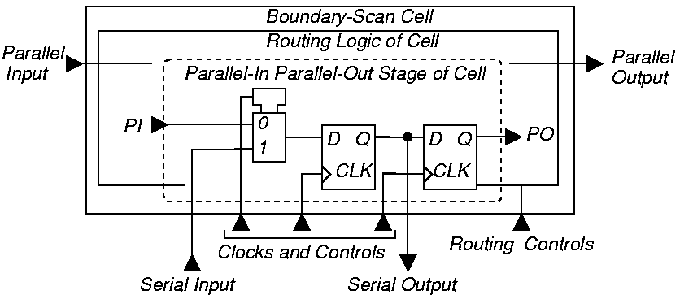
Control & Observe Scan Cell

Slide 4
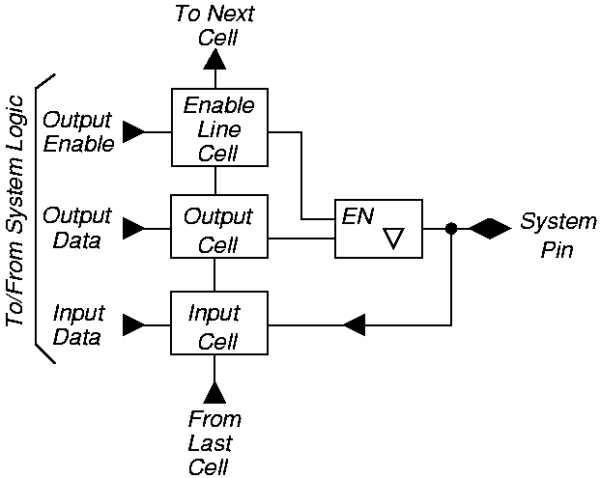
Bidirectional Pins

Slide 5
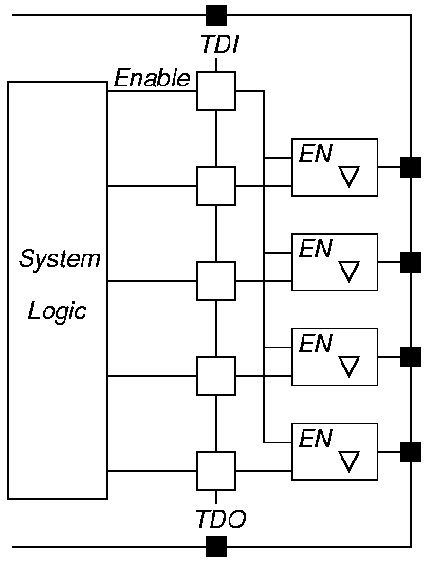
One-Pin Control of Multiple Tri-State Pins

Slide 6
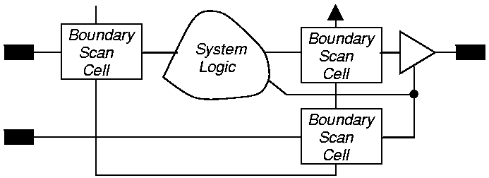
Illegal Cell Use

Slide 7
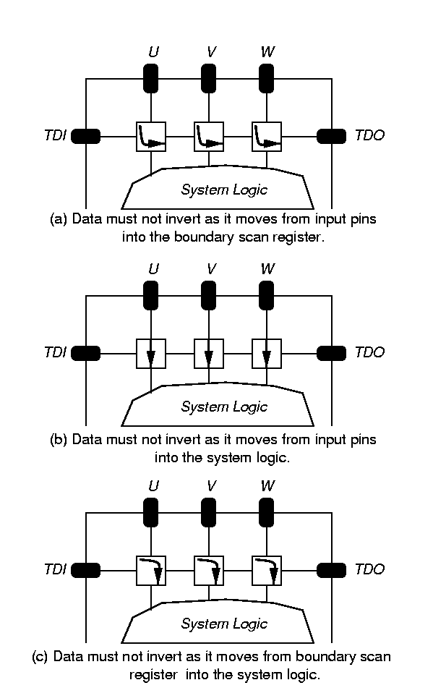
Data Non-Inversion Requirement

Slide 8
System Data Non-Inversion

Slide 9
Cell Delay Constraints
Delay between falling TCK edge and changes at component output pins may be skewed
  May need to avoid simultaneous output switching to save power or avoid burnout
Scan register cells with latched parallel outputs
  May be reset to either logic 0 or 1
    When Test-Logic-Reset TAP controller state entered
    On first falling TCK edge in Test-Logic-Reset state

Slide 10
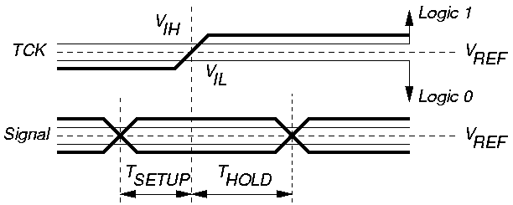
Setup and Hold Time Delay Measurement

Slide 11
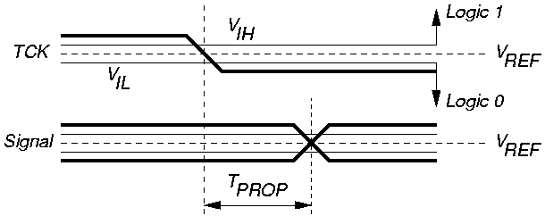
Propagation Delay Measurement Method

Slide 12
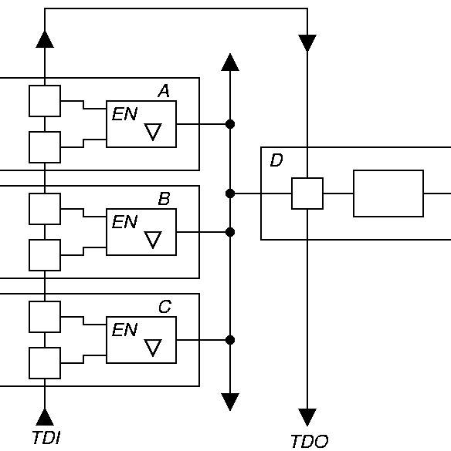
Board Level Bus Test

Slide 13
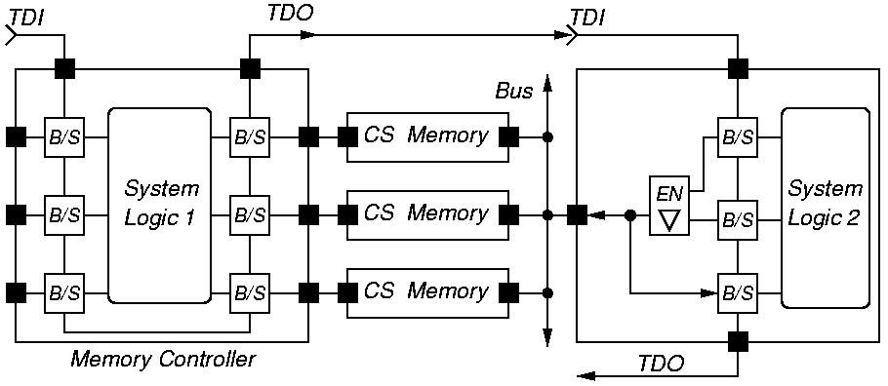
Circuit with Testing Burnout Problem

Slide 14
Purpose of Boundary Scan Description Language (BSDL)
Facilitate communication of information describing test logic of parts:
  Between companies and CAD tools
  Used by automatic test-pattern generators
  Used by synthesis tools to synthesize test logic
Not usable as a simulation model
Cannot describe voltages, currents, or timing
Implemented as subset of VHDL
  Must modify for certain VHDL tools

Slide 15
Features Describable in BSDL
Describable:
  Length & structure of boundary scan reg.
  Availability of optional TRST pin
  Physical locations of TAP pins
  Instruction codes
  Device identification code
Not describable:
  TAP controller state diagram
  Bypass register
  Length of Device Identification Register
  Presence of SAMPLE / PRELOAD, BYPASS, EXTEST instructions
  Operation of user-defined instructions

Slide 16
BSDL Description Components
Entity description -- component-specific test logic parameters
Standard VHDL package & package body
  Defines BSDL subset of VHDL
  Defines commonly used boundary scan cell types
User-specified VHDL packages & package bodies

Slide 17
BSDL Example
entity diff is
generic (Physical_Pin_Map: string:= “Pack”);
port ( TDI, TMS, TCK: in bit;
    TDO: out bit; IN1, IN2: in bit;
    OUT1: out bit; OUT2: buffer bit;
    OUT3: out bit_vector (1 to 8);
    OUT4: out bit_vector (4 downto 1);
    BIDIR1, BIDIR2, BIDIR3: inout bit;
    GND, VCC: linkage bit);
use STD_1194_1_1994.all;
attribute BOUNDARY_REGISTER of diff:entity is ...

Slide 18
Pin Descriptions
Standard USE statement (required):
use STD_1149_1_1994.all;
PIN Types:
  in (input-only)
  out (may be tri-state or open-collector)
  buffer (active, 2-state, always driven)
  inout (bidirectional)
  linkage (power, ground, analog, non-connect)
Relate logical signals to package physical pins
Group ports -- differential voltage or current pairs (one signal is always complement of other)

Slide 19
TAP Descriptions
Says which logical signals comprise the TAP
Specify which input port logic values enable JTAG compliance (part can either conform to JTAG or refuse to conform)
Instruction register description:
  Length
  Op Codes -- can add optional instructions
  Mapping from bit patterns to instruction Op Codes
  Define private instructions
  Specify bit pattern captured in Capture-IR controller state (2 LSB’s are always “01”)
IDCODE and USERCODE register contents

Slide 20
Scan Cell Definitions
Define existence and length of boundary scan register cells -- have these types:
  INPUT -- control & observe, observe-only
  CLOCK -- cell at clock input
  OUTPUT2 -- drives 2-state output
  OUTPUT3 -- drivers 3-state output
  CONTROL -- controls 3-state output
  CONTROLR -- disabled in Test-Logic-Reset state
  INTERNAL -- not associated with digital pin
  BIDIR -- reversible cell for bidirectional pin
  OBSERVE_ONLY -- single input observe-only cell
Define which instructions access which registers

Slide 21
Summary
Boundary Scan Standard has become absolutely essential --
  No longer possible to test printed circuit boards with bed-of-nails tester
  Not possible to test multi-chip modules at all without it
  Supports BIST, external testing with Automatic Test Equipment, and boundary scan chain reconfiguration as BIST pattern generator and response compacter
  Now getting widespread usage

